Slide 1


Resilient Federated Vision Transformers for Alzheimer’s Disease Prediction with Brain Imaging Data Jittering
Mahyar Mohammadi Mohammad Mashreghi
Supervisor : Dr. Kebriaei

Slide 2
5
Road Map
Our Results
4
Robustness in FL Different Robustness Approaches
3
DesnsNet121 ResNet18 Vision Transformers
2
Federated Learning Different FL Algorithms
1
Alzheimer’s Disease The Dataset

Slide 3

Alzheimer’s Disease
Alzheimer’s disease
Federated Learning
Neural Networks
Vision Transformers
Different Robustness Approaches
Our results
Robustness in FL
Non Demented
Mild Demented
Moderated Demented
Severe Demented
Notes:
crowds

Slide 4
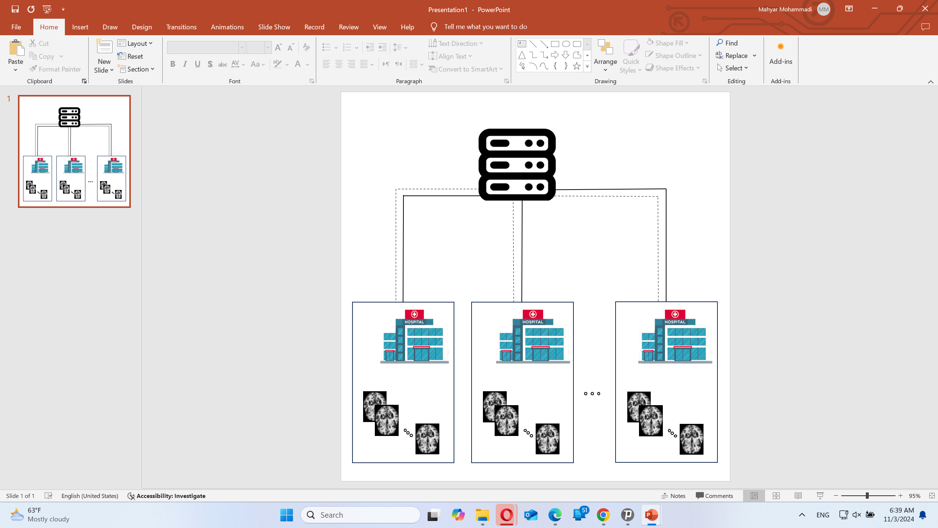
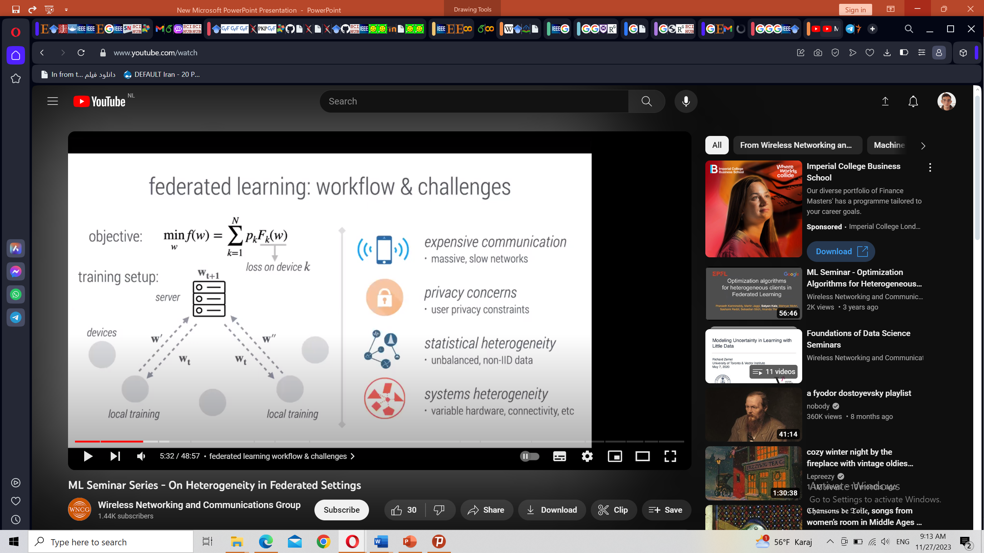
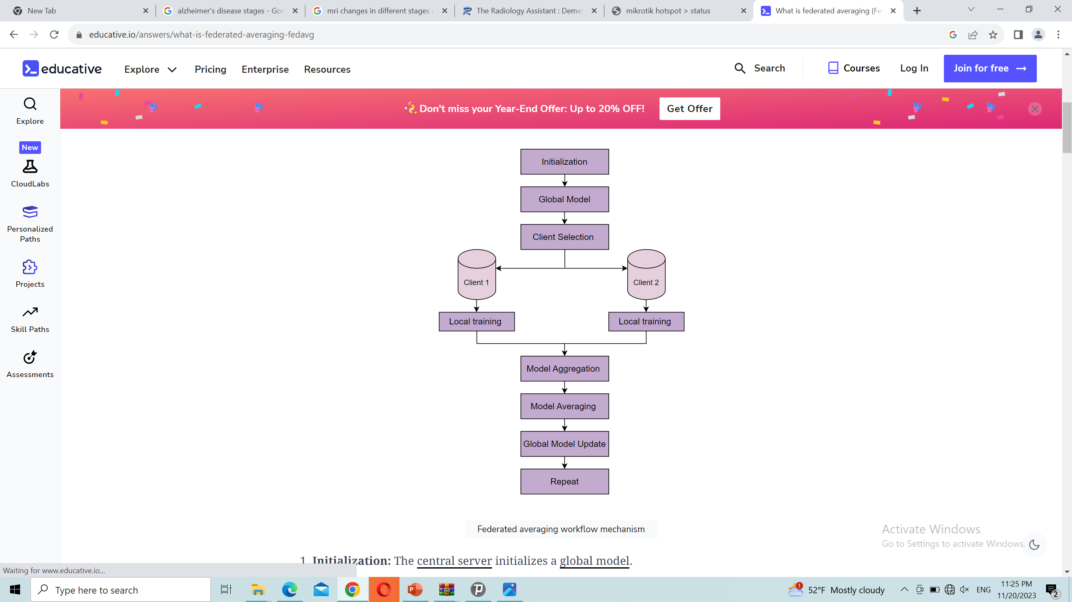
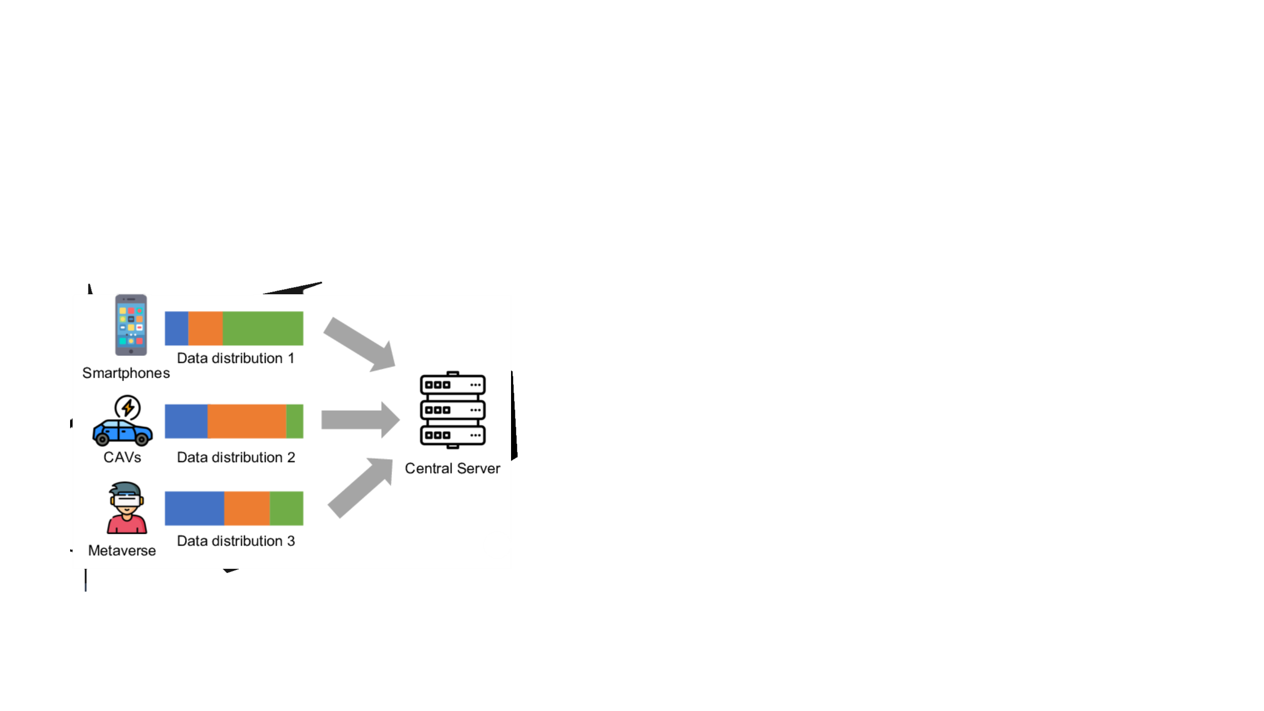
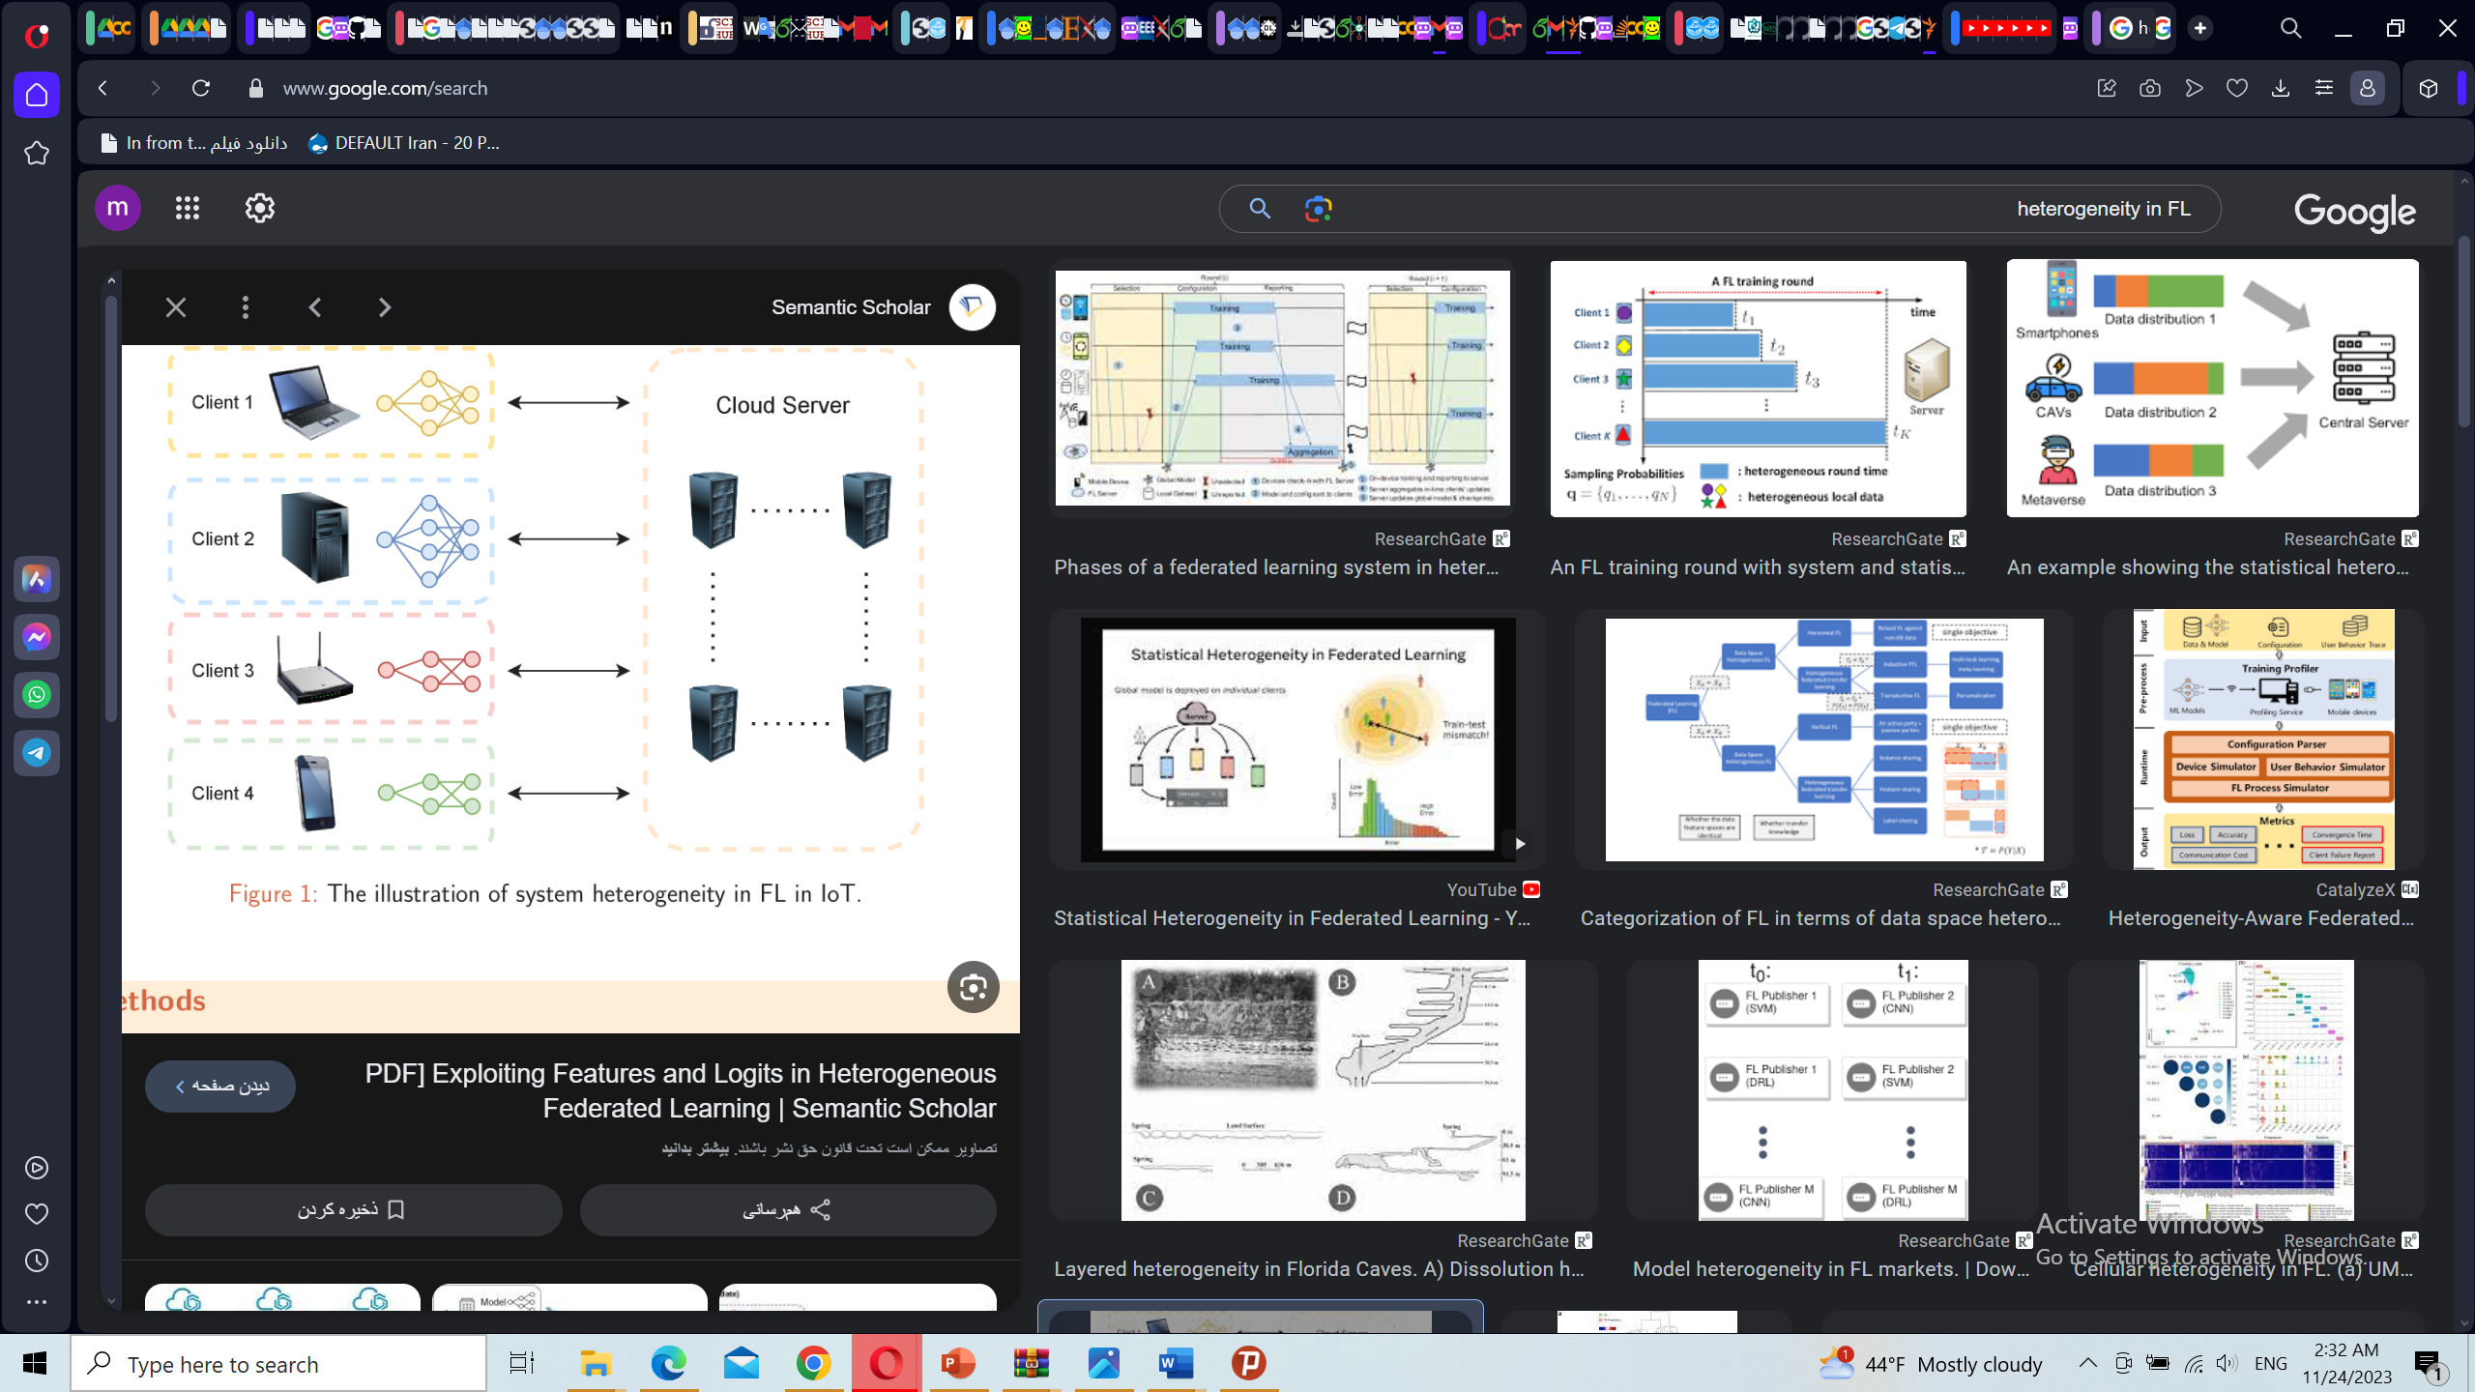
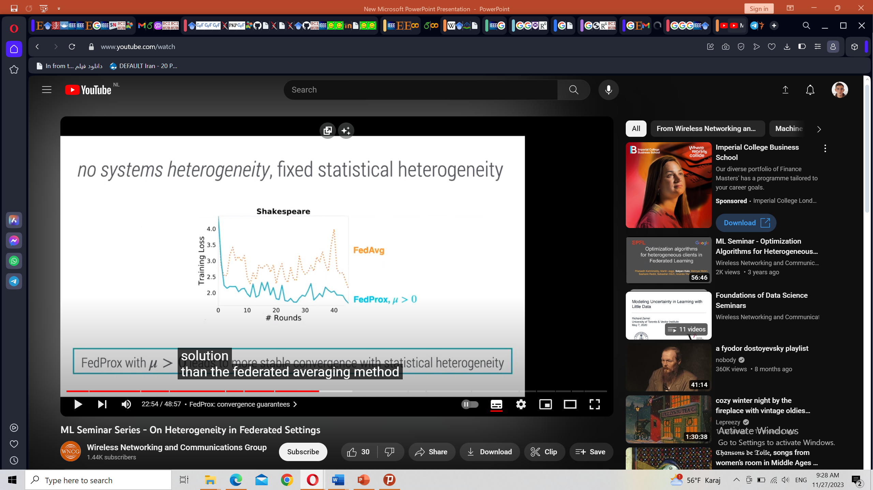
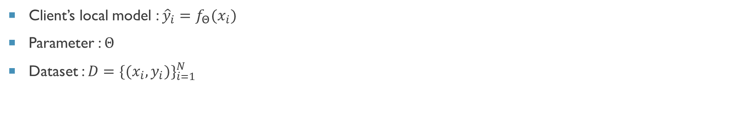
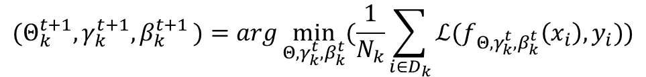
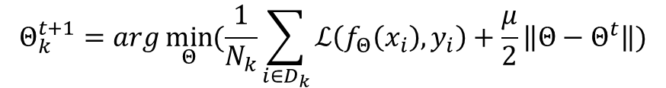
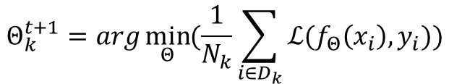
Federated Learning
Alzheimer’s disease
Federated Learning
Neural Networks
Vision Transformers
Different Robustness Approaches
Our results
Robustness in FL
Client’s local model : ${{\hat{y}}_{i}=f}_{Θ}(x_{i})$
Parameter : $Θ$
Dataset : $D={\{(x_{i},y_{i})\}}_{i=1}^{N}$
FedAvg
Patient Privacy Protection
Data Silos Access
Model Performance
Resource Efficiency
Geographical Efficiency
$$Θ_{k}^{t+1}=arg\min_{Θ}{(\frac{1}{N_{k}}\sum_{i∈D_{k}}{ℒ(f_{Θ}\left(x_{i}\right),y_{i})})}$$
FedProx
$$Θ_{k}^{t+1}=arg\min_{Θ}{(\frac{1}{N_{k}}\sum_{i∈D_{k}}{ℒ\left(f_{Θ}\left(x_{i}\right),y_{i}\right)}+\frac{μ}{2}\left\|Θ−Θ^{t}\right\|)}$$
FedBN (Federated Batch Normalization)
$${(Θ}_{k}^{t+1},γ_{k}^{t+1}{,β}_{k}^{t+1})=arg\min_{Θ,γ_{k}^{t}{,β}_{k}^{t}}{(\frac{1}{N_{k}}\sum_{i∈D_{k}}{ℒ(f_{Θ,γ_{k}^{t}{,β}_{k}^{t}}\left(x_{i}\right),y_{i})})}$$
Notes:
crowds

Slide 5
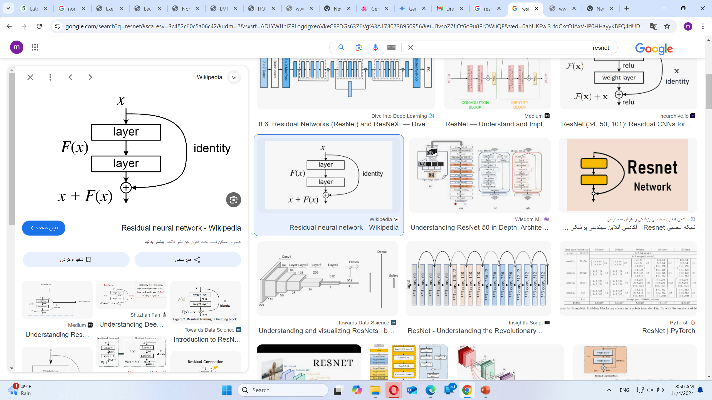
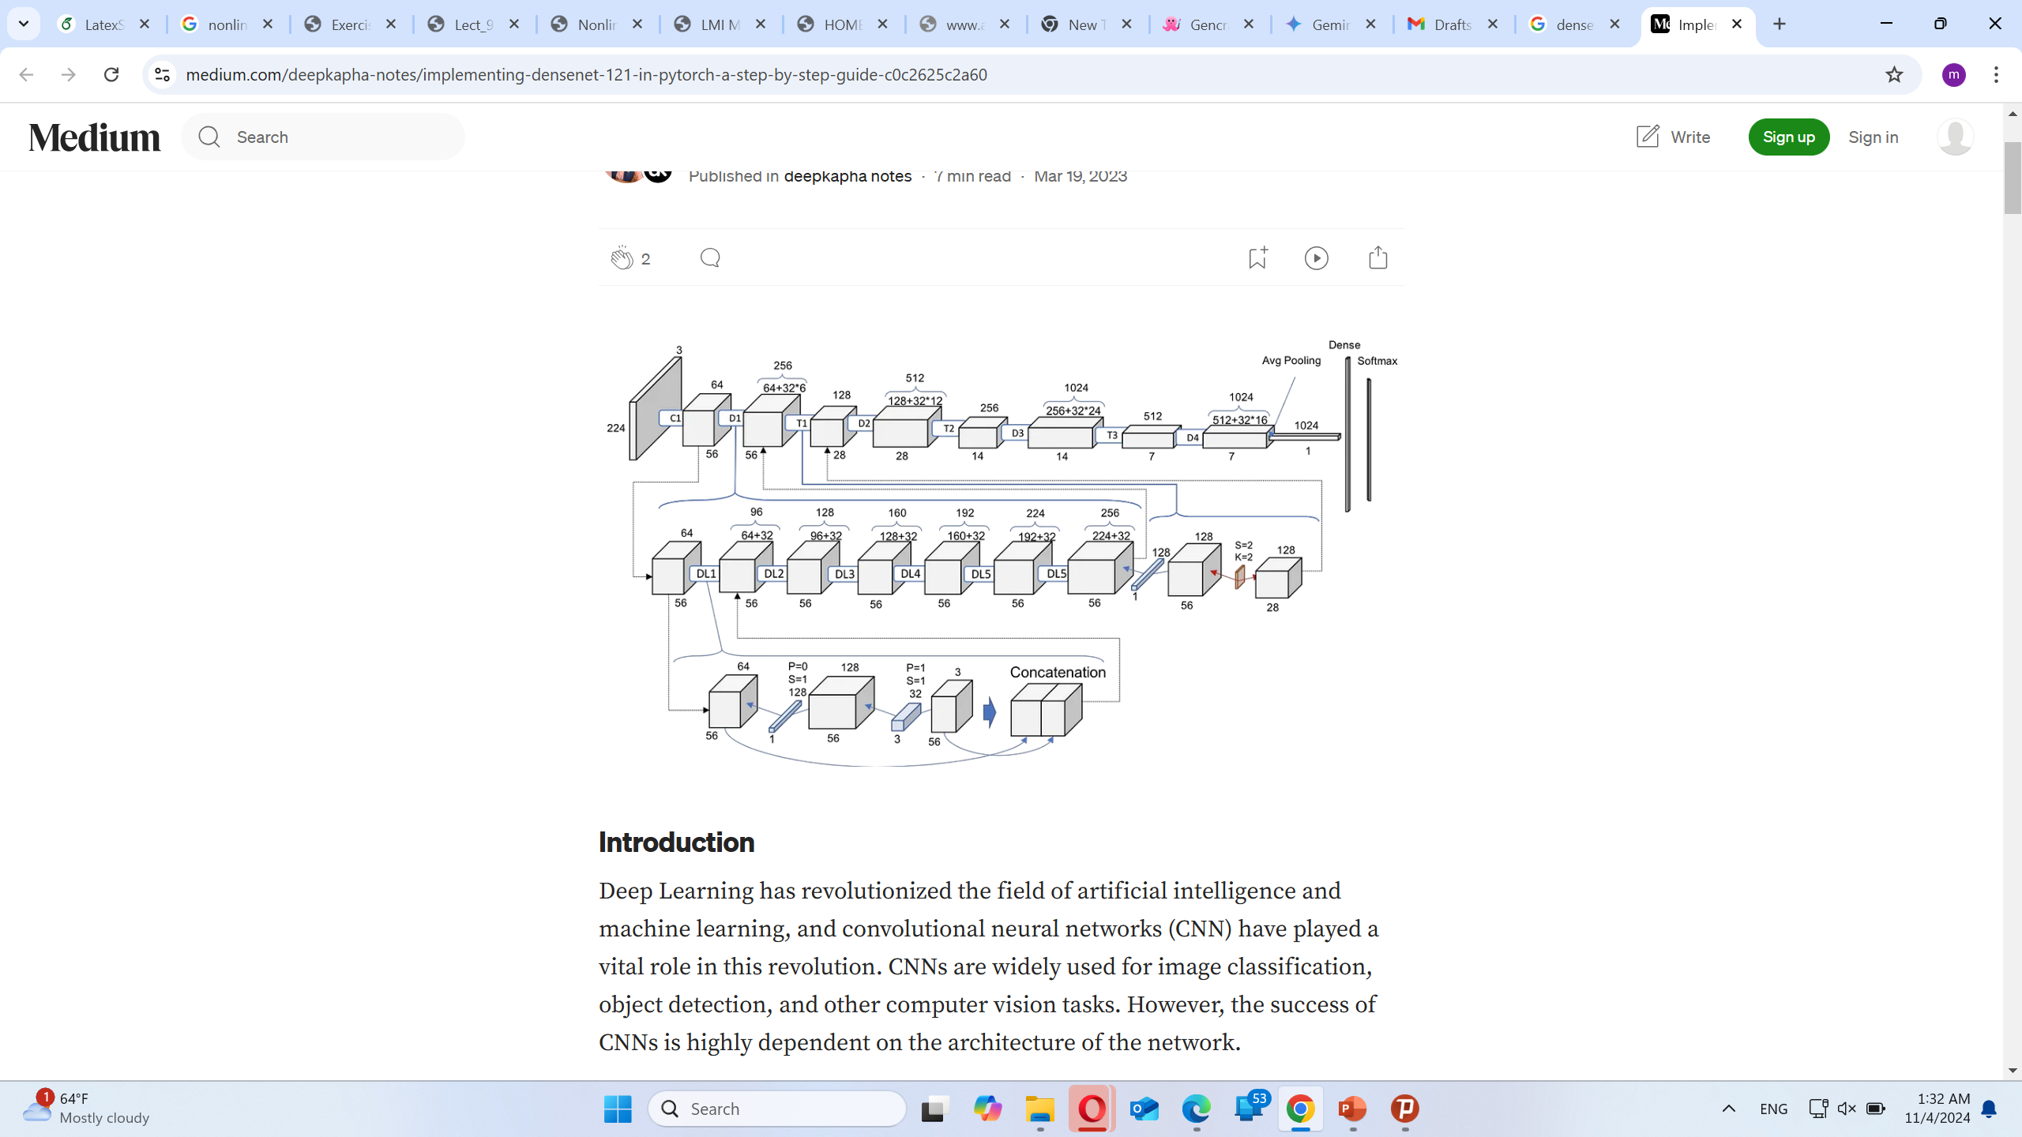
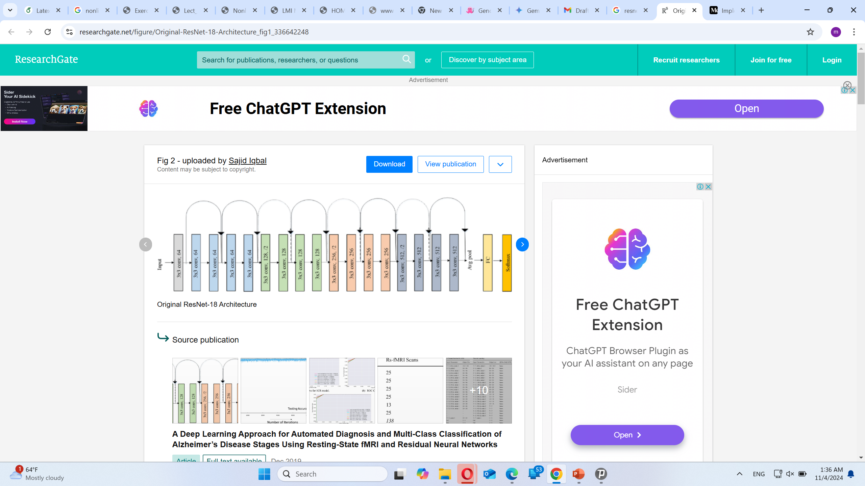
Neural Network architecture
Alzheimer’s disease
Federated Learning
Neural Networks
Vision Transformers
Different Robustness Approaches
Our results
Robustness in FL
DensNet121
ResNet18
Notes:
crowds

Slide 6
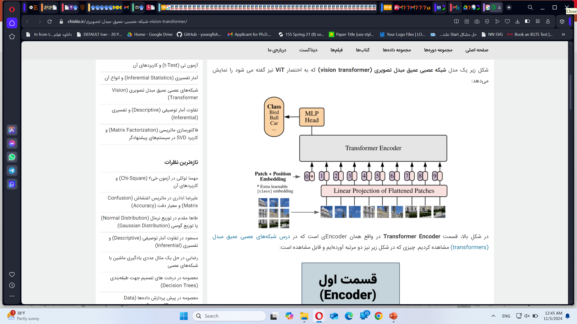
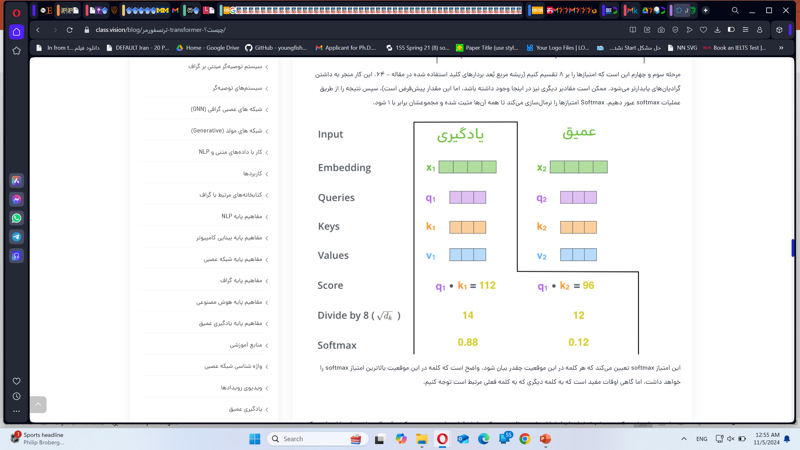
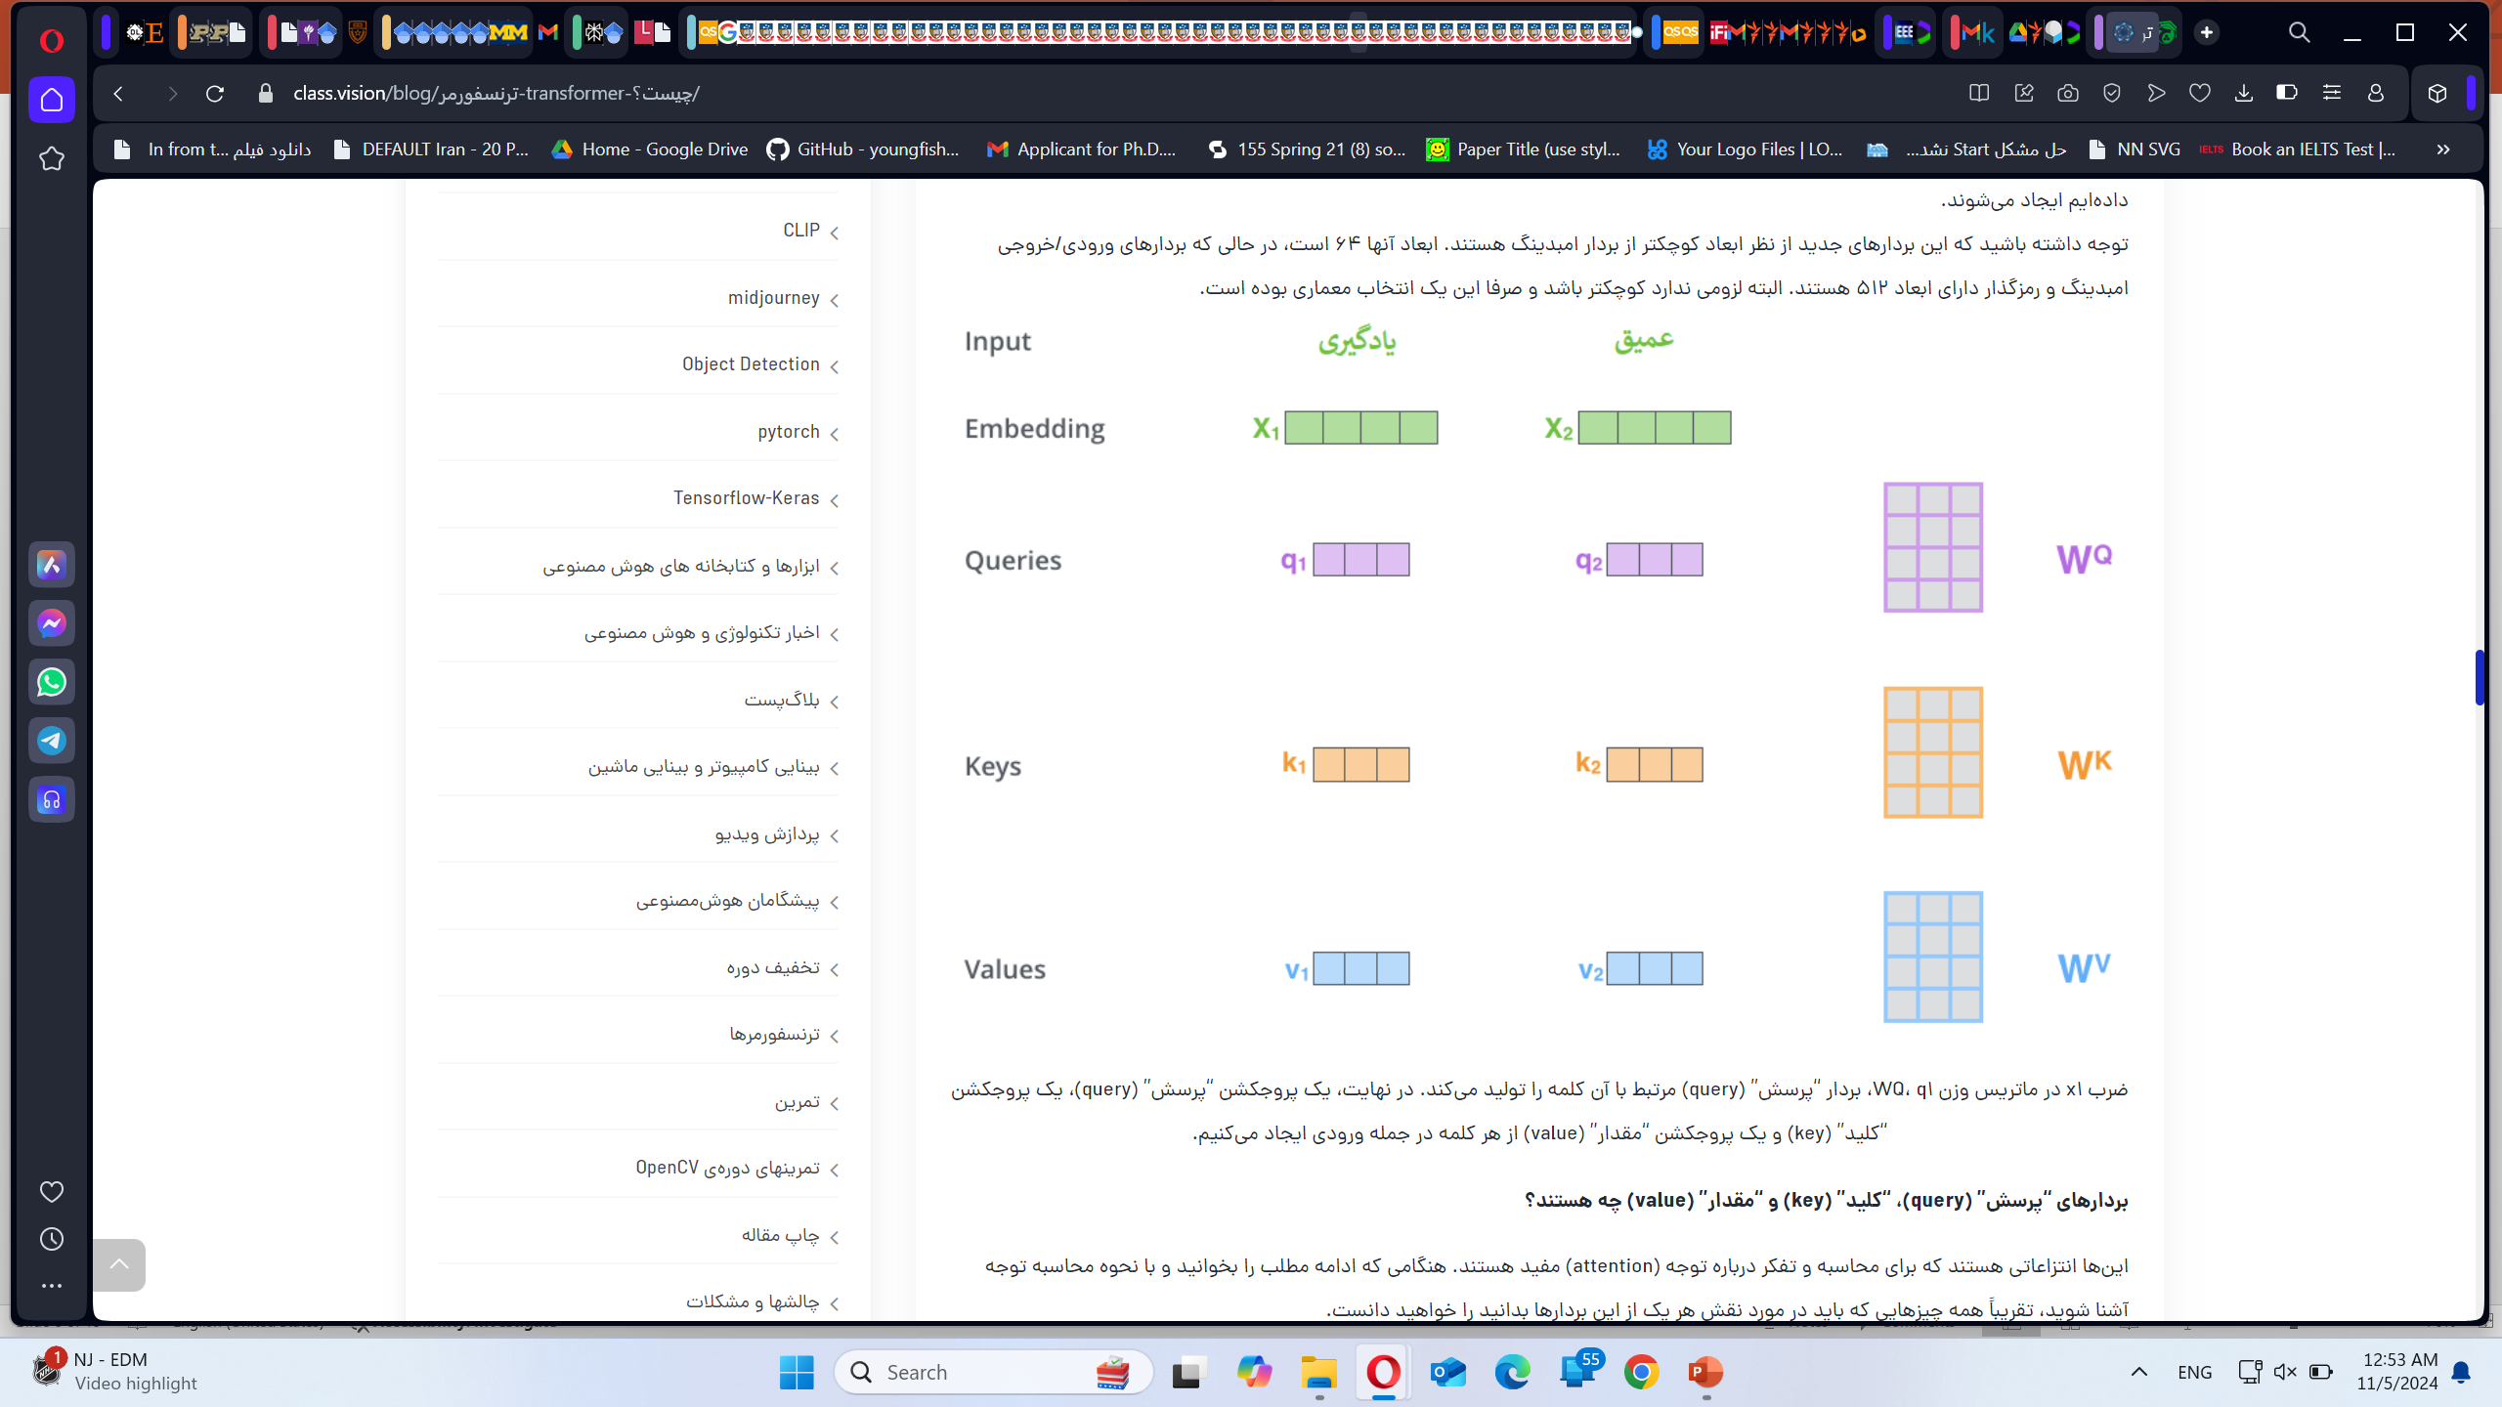
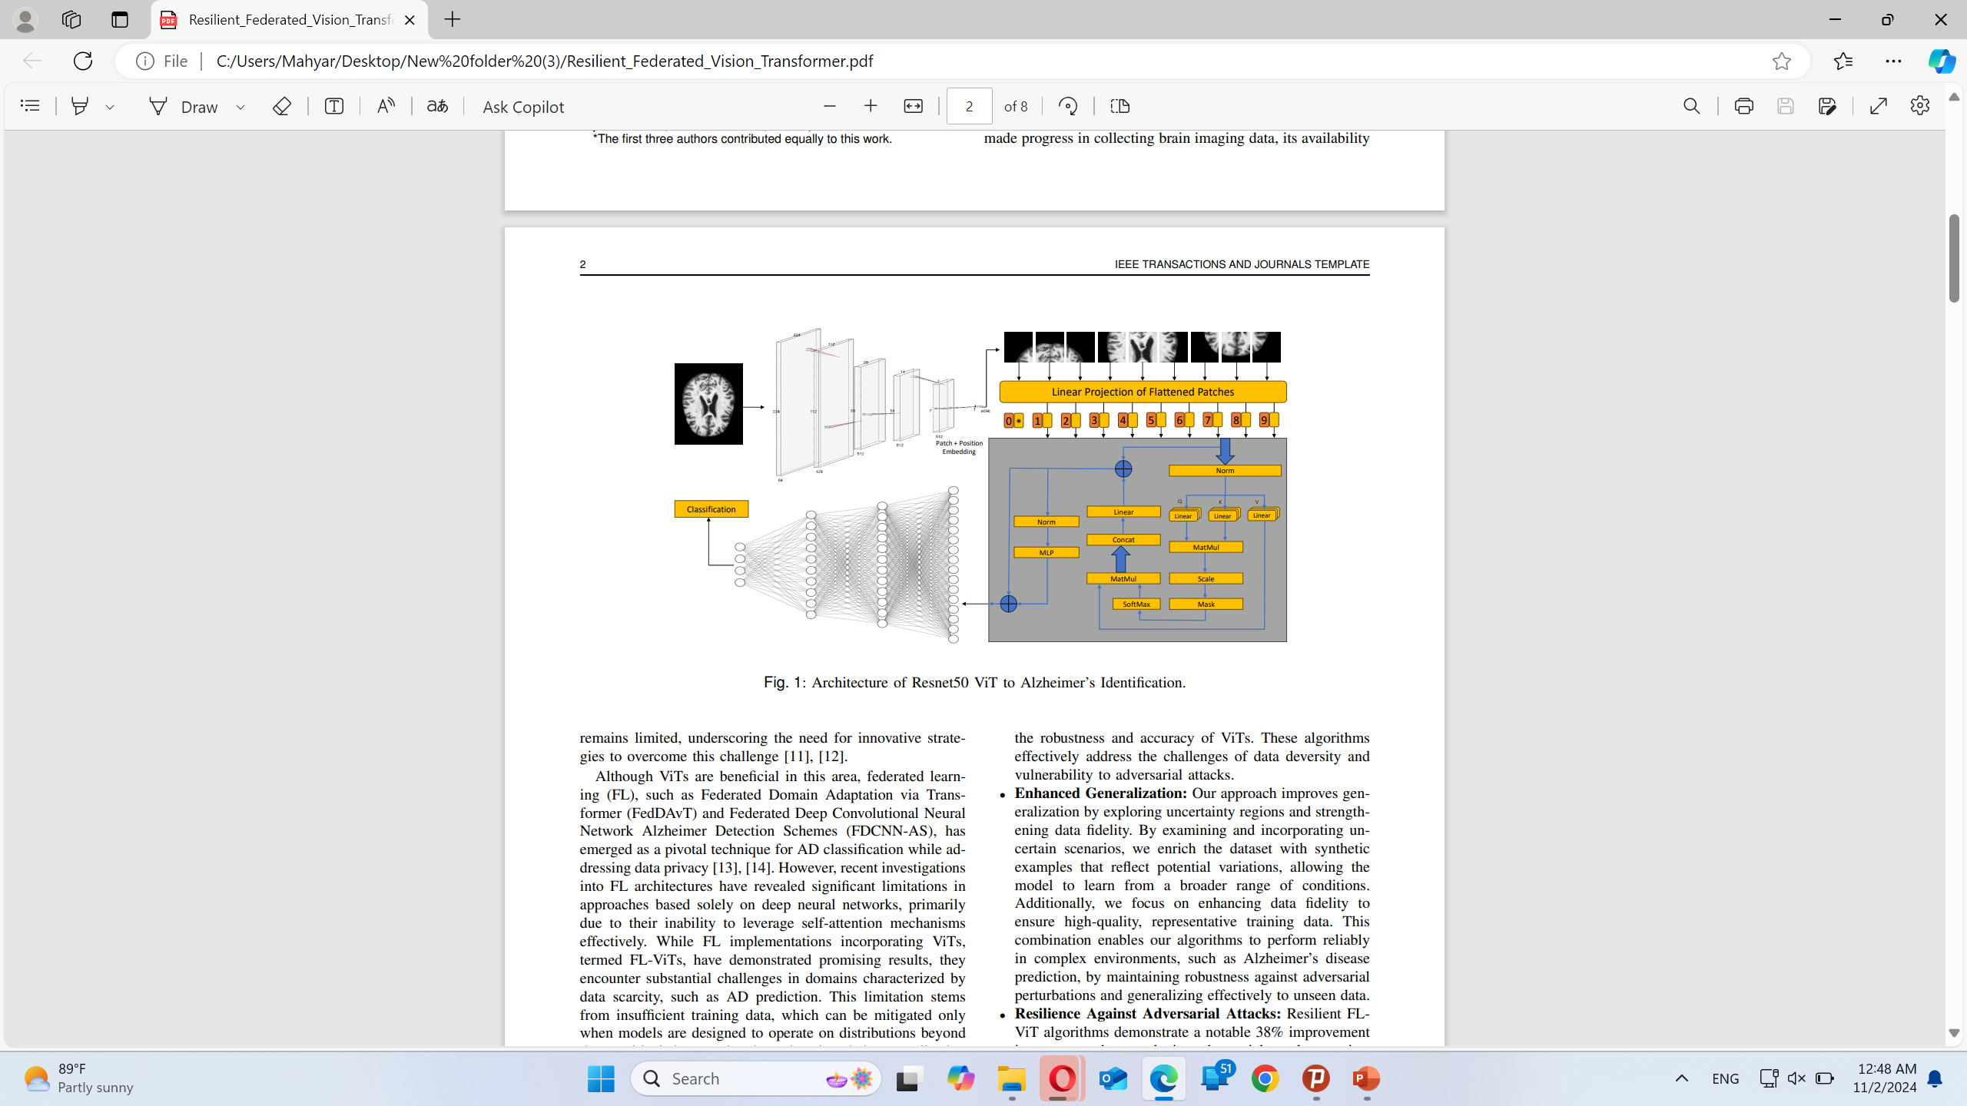
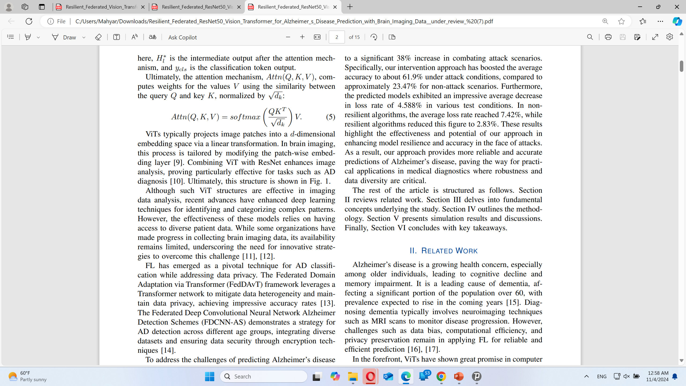
Vision Transformers
Alzheimer’s disease
Federated Learning
Neural Networks
Vision Transformers
Different Robustness Approaches
Our results
Robustness in FL
Parallel Processing
Embedding
Attention Mechanism
Notes:
crowds

Slide 7
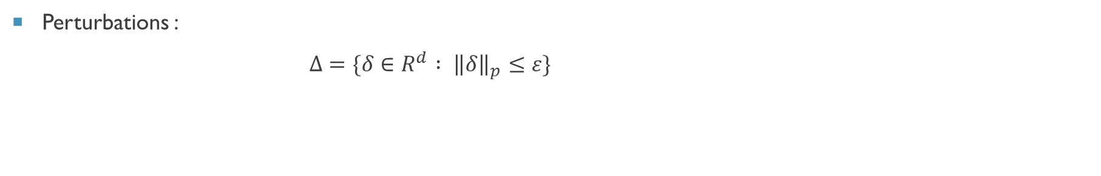
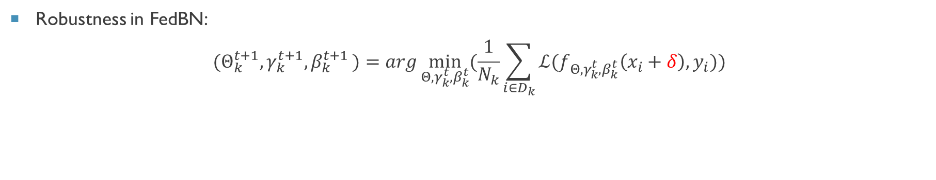
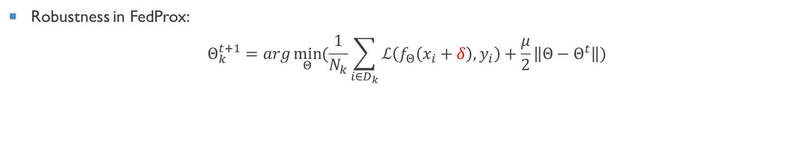
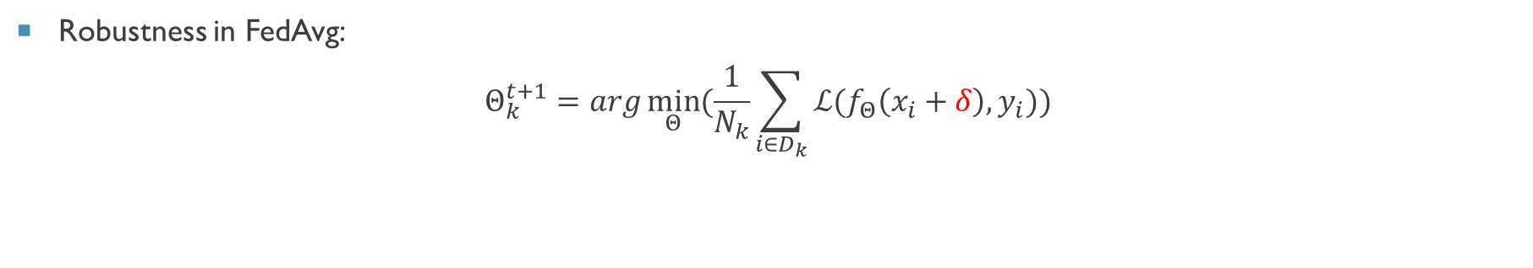
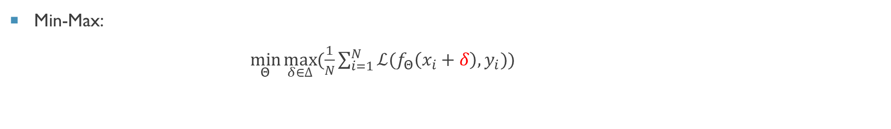
Robustness Definition
Alzheimer’s disease
Federated Learning
Neural Networks
Vision Transformers
Different Robustness Approaches
Our results
Robustness in FL
Perturbations :
$Δ=\{δ∈R^{d} : {\left\|δ\right\|}_{p}≤ε\}$
Min-Max:
$\min_{Θ}{\max_{δ∈∆}{(\frac{1}{N}\sum_{i=1}^{N}{{ℒ(f}_{Θ}\left(x_{i}+δ\right),y_{i}}))}}$
Robustness in FedAvg:
$$Θ_{k}^{t+1}=arg\min_{Θ}{(\frac{1}{N_{k}}\sum_{i∈D_{k}}{ℒ(f_{Θ}\left(x_{i}+δ\right),y_{i})})}$$
Robustness in FedProx:
$$Θ_{k}^{t+1}=arg\min_{Θ}{(\frac{1}{N_{k}}\sum_{i∈D_{k}}{ℒ\left(f_{Θ}\left(x_{i}+δ\right),y_{i}\right)}+\frac{μ}{2}\left\|Θ−Θ^{t}\right\|)}$$
Robustness in FedBN:
$${(Θ}_{k}^{t+1},γ_{k}^{t+1}{,β}_{k}^{t+1})=arg\min_{Θ,γ_{k}^{t}{,β}_{k}^{t}}{(\frac{1}{N_{k}}\sum_{i∈D_{k}}{ℒ(f_{Θ,γ_{k}^{t}{,β}_{k}^{t}}\left(x_{i}+δ\right),y_{i})})}$$
Notes:
crowds

Slide 8
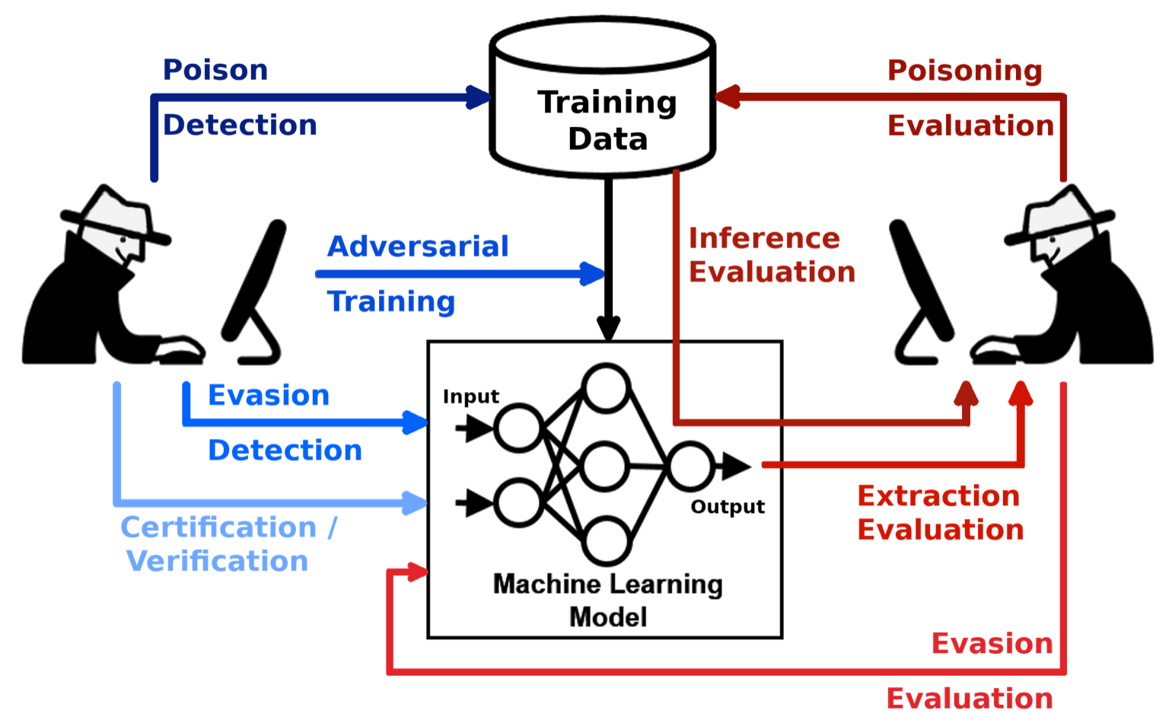
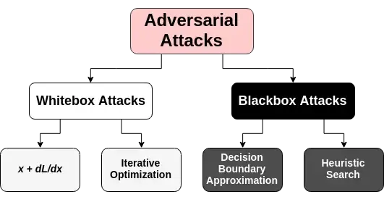
Robustness in FL
Alzheimer’s disease
Federated Learning
Neural Networks
Vision Transformers
Different Robustness Approaches
Our results
Robustness in FL
Image source
Image source
Notes:
Adversarial Attacks
Evasion Attacks: Adding small, often imperceptible, perturbations to input data (like images or text) that cause the model to make incorrect predictions. Examples include:
FGSM (Fast Gradient Sign Method): A quick method to find adversarial examples by tweaking inputs along the gradient direction.
PGD (Projected Gradient Descent): An iterative approach that optimizes perturbations in small steps.
DeepFool: Creates minimal perturbations to push an input to the decision boundary of the wrong class.
Poisoning Attacks: Injecting carefully crafted malicious samples into the training dataset, making the model vulnerable to specific inputs.
Backdoor Attacks: Embedding a hidden trigger in the training data, so when the trigger is present, the model outputs a specific, attacker-chosen class.
Model Inversion Attacks These attacks aim to reconstruct private information from the model’s output. By accessing certain model predictions, attackers can retrieve sensitive information about the training data, especially in models trained on private datasets.
Membership Inference Attacks These attacks try to determine whether a specific data point was part of the model’s training set, exploiting overfitting in DNNs. They’re a serious privacy concern, especially in sensitive applications like medical or financial data.
Model Extraction Attacks Also known as "model stealing," these attacks aim to replicate or clone a DNN by querying it and gathering enough input-output pairs to build a replica. This is common in cloud-based AI services where the model can be accessed but not downloaded.
Trojan Attacks Trojan attacks involve modifying a DNN model such that it behaves normally in most cases but triggers malicious outputs when specific hidden triggers are present. Unlike poisoning, Trojans are often embedded directly in the model post-training.
Data Poisoning Attacks In data poisoning, attackers manipulate the training data to degrade the model’s performance or to control its predictions, sometimes targeting specific classes or inputs.
ensembled network (white-box setting) and the hold-out network (black-box setting) White-Box Systems
In a white-box system:
Full Access to Model Details: The adversary or user has complete knowledge of the model, including its architecture, weights, gradients, and all internal parameters.
Easier to Craft Attacks: With access to gradients, attackers can easily perform gradient-based attacks (like Fast Gradient Sign Method or Projected Gradient Descent) by computing precise perturbations to mislead the model.
Use in Development and Research: White-box settings are common for model training, debugging, and research as they allow fine-grained control and insight into how the model learns and behaves.
Black-Box Systems
In a black-box system:
Limited Access to Model Details: The adversary or user does not have access to the model’s internal parameters or gradients. They only see the input-output behavior, such as predictions or confidence scores for each input.
Harder to Craft Attacks: Without gradient information, attackers must use alternative strategies, like approximating the model through queries (Query-based Attacks) or leveraging another model trained to mimic the black-box model (Transfer Attacks).
Real-World Application: Black-box settings are common in deployed systems where model details are hidden for security, privacy, or proprietary reasons, such as in cloud services or deployed machine learning applications.
Summary
White-Box: Full knowledge of model internals; facilitates gradient-based, precise attacks.
Black-Box: Limited to input-output interactions; requires alternative attack strategies like model approximation or transfer learning.

Slide 9
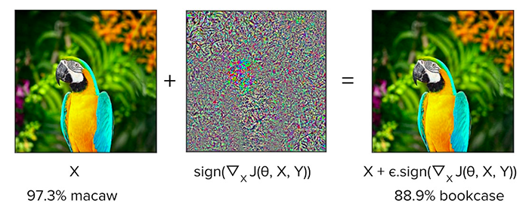
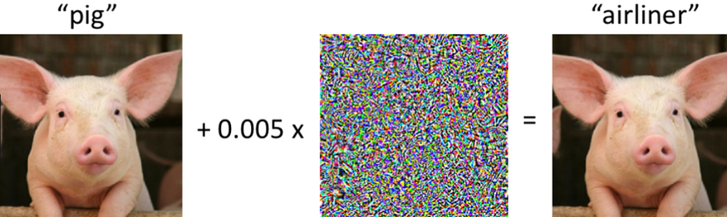
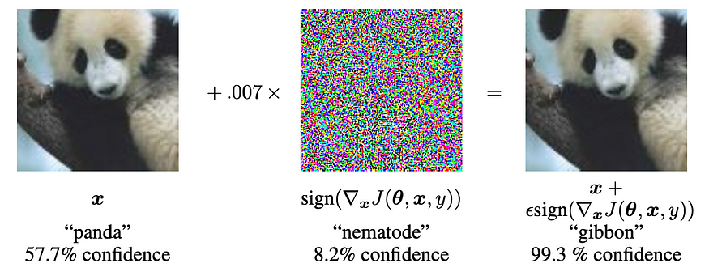
Robustness in FL
Alzheimer’s disease
Federated Learning
Neural Networks
Vision Transformers
Different Robustness Approaches
Our results
Robustness in FL
Image source
A demonstration of fast adversarial example generation applied to GoogLeNet (Szegedy et al., 2014) on ImageNet
Notes:
crowds

Slide 10
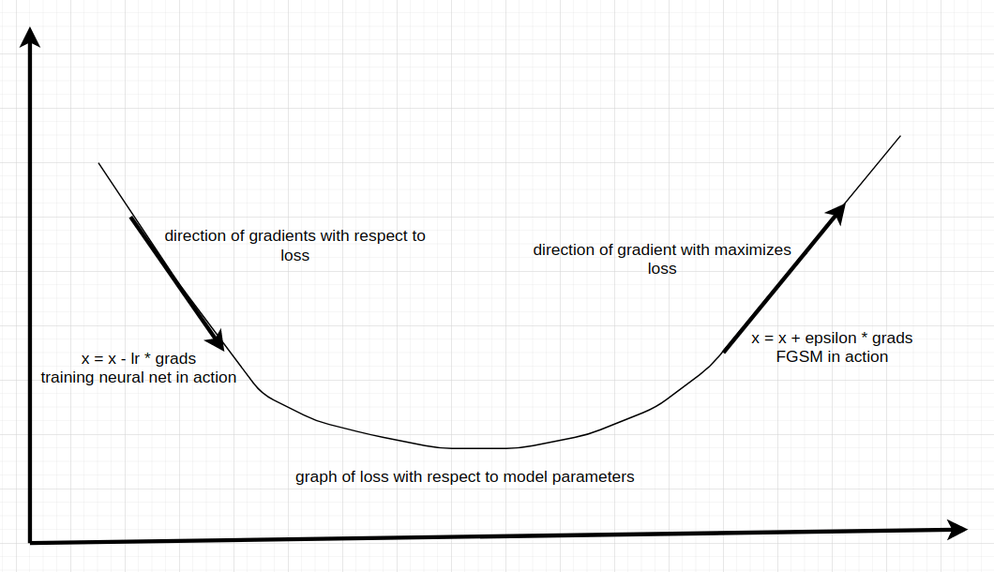
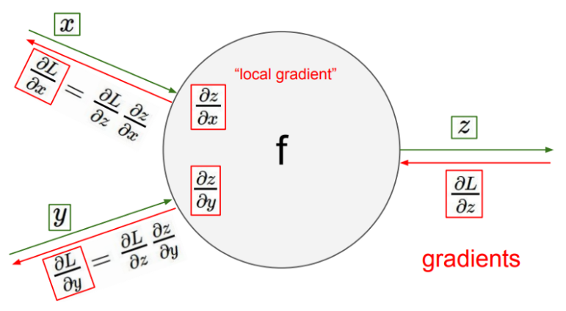
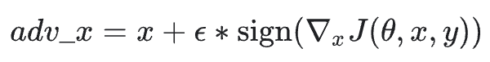
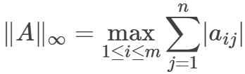
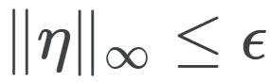
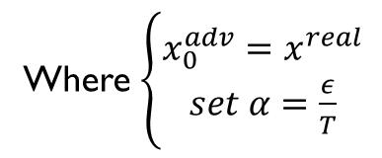
Robustness in FL (FGSM)
Alzheimer’s disease
Federated Learning
Neural Networks
Vision Transformers
Different Robustness Approaches
Our results
Robustness in FL
Image source
Image source
IBM or : I-FGSM
Where $\left\{\begin{aligned}x_{0}^{adv}=x^{real} \\ set α=\frac{ε}{T}\end{aligned}\right.$
Notes:
crowds

Slide 11
Robustness in FL (FGSM)
Advantages of FGSM
Simplicity — FGSM is easy to understand and implement.
Efficiency — It requires only one forward and backward pass through the model.
Transferability — Adversarial examples generated with FGSM on one model often transfer to others.
Limitations and Mitigations
Limited Robustness — Adversarial examples crafted by FGSM may not be robust to diverse transformations.
Known Vulnerability — FGSM is vulnerable to defense strategies, prompting the need for more sophisticated adversarial training methods.
Alzheimer’s disease
Federated Learning
Neural Networks
Vision Transformers
Different Robustness Approaches
Our results
Robustness in FL
Notes:
crowds

Slide 12
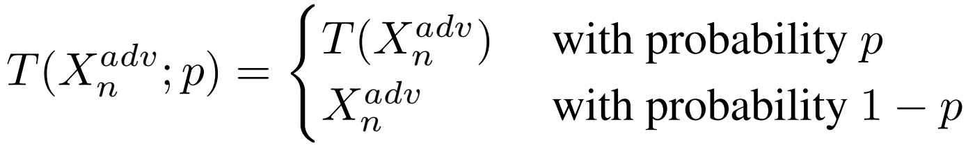
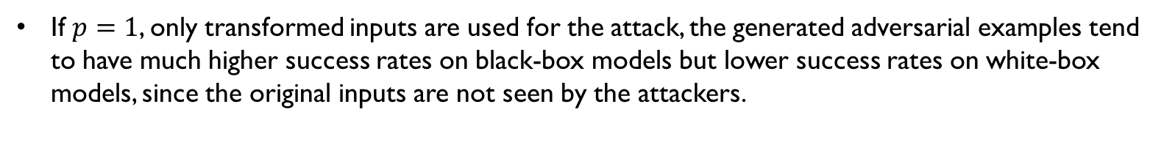
Robustness in FL (DI-FGSM)
Alzheimer’s disease
Federated Learning
Neural Networks
Vision Transformers
Different Robustness Approaches
Our results
Robustness in FL
DI-FGSM = Data Augmentation + I-FGSM
If $p=0$, DI^2-FGSM become I-FGSM, which leads to overfitting
If $p=1$, only transformed inputs are used for the attack, the generated adversarial examples tend to have much higher success rates on black-box models but lower success rates on white-box models, since the original inputs are not seen by the attackers.
Notes:
Overfitting in Adversarial Attacks: When creating adversarial examples, overfitting occurs if these examples are too finely tuned to a particular model's parameters. This tuning increases the attack's success on the target model (white-box setting) but decreases its effectiveness on different models (black-box setting). In simpler terms, the adversarial example becomes too specific to one model, thus losing its effectiveness on others. Underfitting in Adversarial Attacks: If adversarial examples are generated with a single-step method, they might underfit because they lack specific tuning to any model. This often makes them less effective in white-box settings but more transferable to black-box settings.

Slide 13
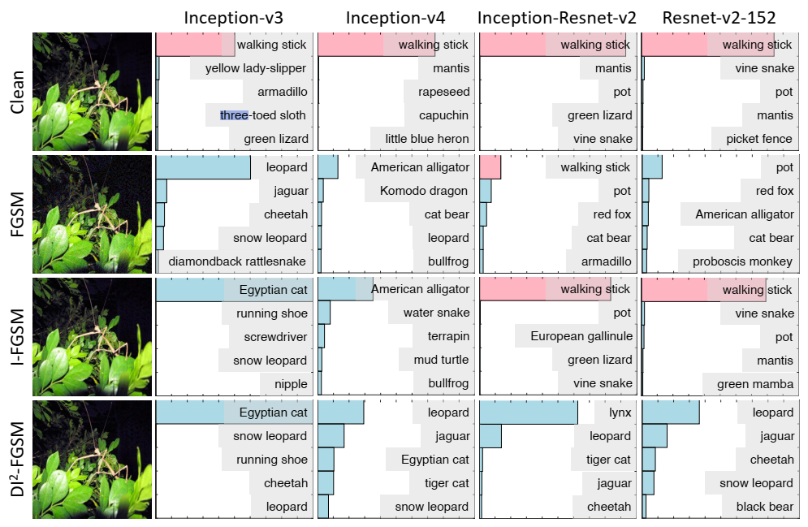
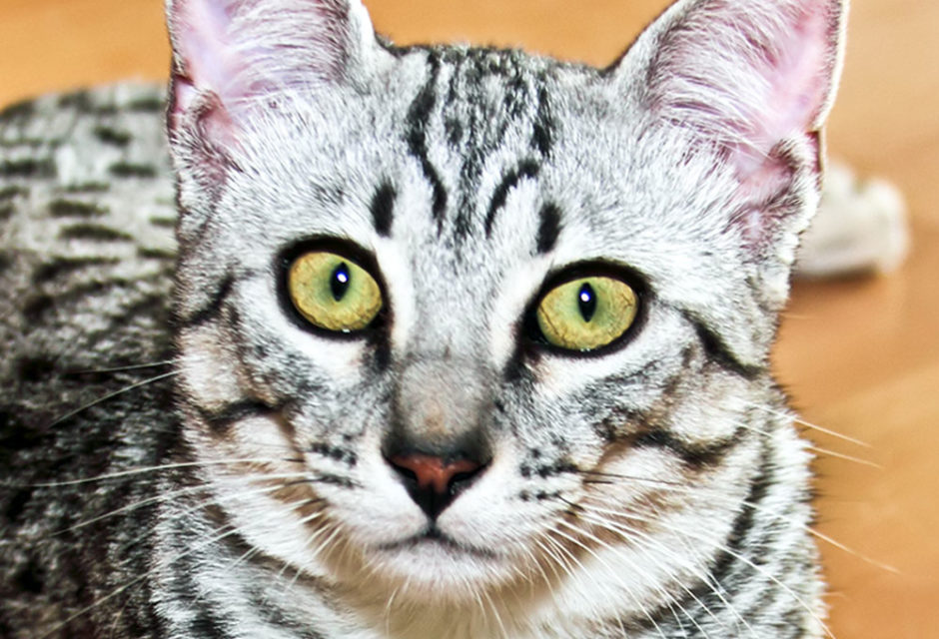
Robustness in FL (DI-FGSM)
Alzheimer’s disease
Federated Learning
Neural Networks
Vision Transformers
Different Robustness Approaches
Our results
Robustness in FL
Advantages
Enhanced Transferability: Random transformations make adversarial examples work across models.
Defense Evasion: Randomness helps avoid detection by defenses.
Efficient: Lightweight transformations make each iteration effective.
Disadvantages
More Computation: Extra transformations slow down the process.
Lower White-Box Success: Transferability can reduce white-box accuracy.
Transformation Dependency: Effectiveness relies on optimal transformation settings.
Improving Transferability of Adversarial Examples with Input Diversity
Notes:
Advantages Enhanced Transferability: DI-FGSM applies random transformations (such as resizing and padding) to each input at every iteration, which helps adversarial examples generalize across different models. This is particularly useful for black-box attacks, as it makes the adversarial example less dependent on a single model’s specifics. Robustness Against Defenses: By adding randomness through transformations, DI-FGSM prevents overfitting to the structure of any one model, making it harder for defenses to detect adversarial patterns. This randomness allows the generated adversarial example to evade defenses that focus on static input structures. Efficient for Iterative Attacks: Although it’s iterative, DI-FGSM is relatively efficient in terms of transferability gains per iteration. The transformations are computationally lightweight compared to more complex adversarial attack techniques. Disadvantages Computational Overhead: The additional transformations (resizing and padding) at each iteration increase

Slide 14
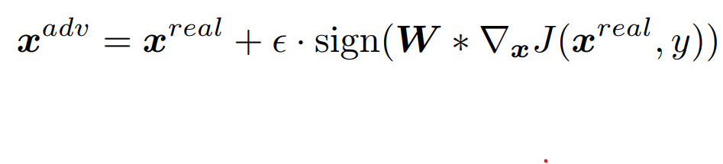
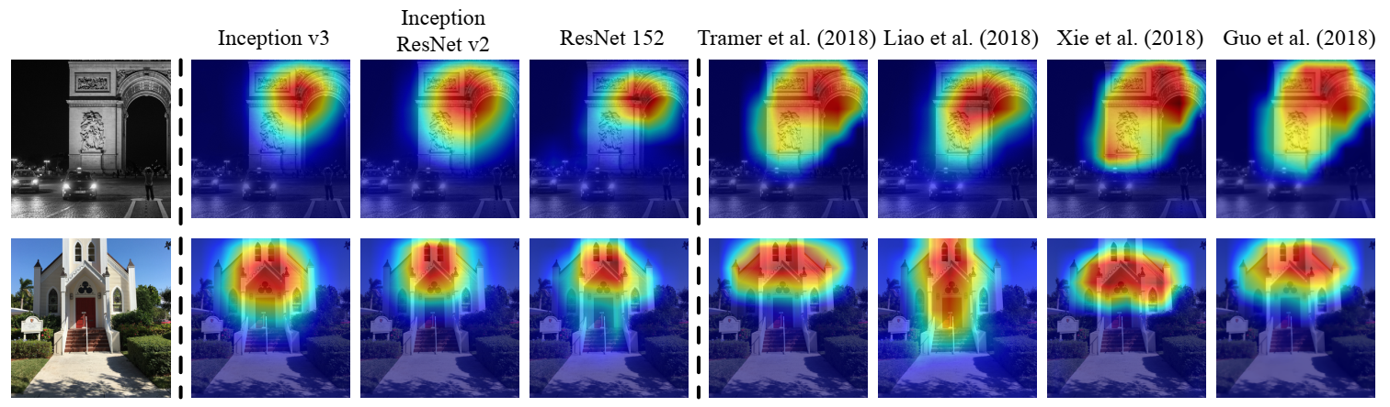
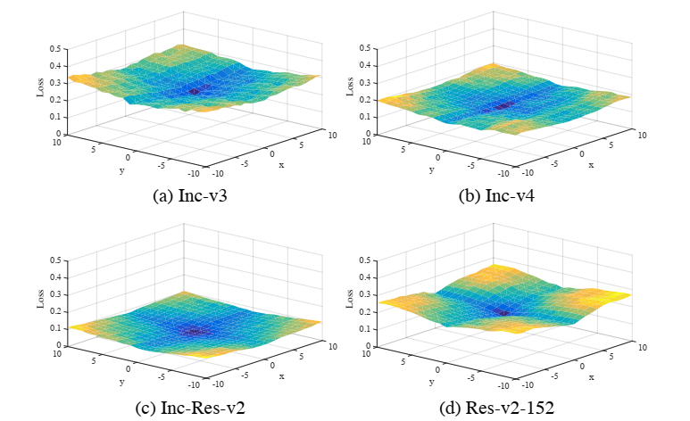
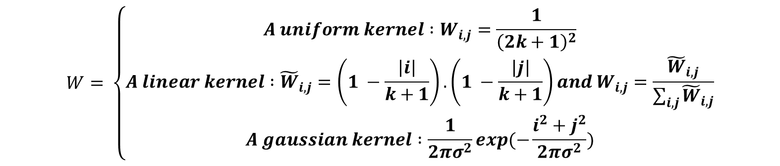
Robustness in FL (TI-FGSM)
Alzheimer’s disease
Vision Transformers
Federated Learning
FL algorithms
Robustness in FL
Different Robustness Approaches
FLs under attack
Our results
$$W= \left\{\begin{aligned}A uniform kernel :W_{i,j}=\frac{1}{{\left(2k+1\right)}^{2}} \\ A linear kernel :{\tilde{W}}_{i,j}=\left(1 −\frac{\left|i\right|}{k+1}\right).\left(1 −\frac{\left|j\right|}{k+1}\right)and W_{i,j}=\frac{{\tilde{W}}_{i,j}}{\sum_{i,j}{{\tilde{W}}_{i,j}}} \\ A gaussian kernel :\frac{1}{2πσ^{2}}exp(−\frac{i^{2}+j^{2}}{2πσ^{2}})\end{aligned}\right.$$
Evading Defenses to Transferable Adversarial Examples by Translation-Invariant Attacks
Notes:
crowds

Slide 15
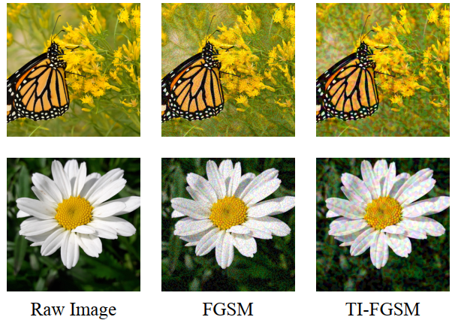
Robustness in FL (TI-FGSM)
Advantages
Improved Transferability
Resistance to Small Defenses
Generalization Across Architectures
Disadvantages
Higher Computational Cost
Less Effective in White-Box Attacks
Limited Effectiveness on Large Transformations
Alzheimer’s disease
Federated Learning
Neural Networks
Vision Transformers
Different Robustness Approaches
Our results
Robustness in FL
Notes:
Advantages Improved Transferability: By using translation-invariant gradients, TI-FGSM generates adversarial examples that are effective across multiple models. This is particularly beneficial in black-box settings where the attacker doesn’t know the exact model used. Resistance to Small Defenses: The translation invariance makes adversarial examples less sensitive to minor model differences or small image transformations, so they can bypass defenses that target specific features or locations in the image. Generalization Across Architectures: Since it crafts adversarial examples that work across different models, TI-FGSM is valuable in scenarios where multiple models (e.g., in an ensemble) need to be attacked simultaneously. Disadvantages Higher Computational Cost: The iterative nature and convolutional processing make TI-FGSM more computationally demanding than single-step methods like FGSM. The convolution process adds additional complexity to each iteration. Less Effective in White-Box Attacks: TI-FGSM’s

Slide 16
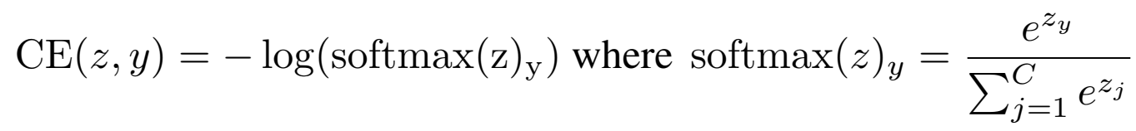
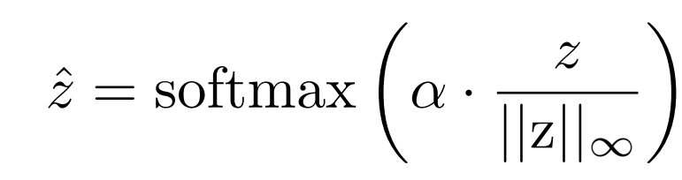
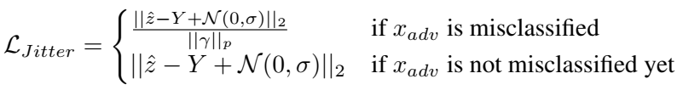
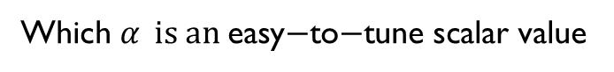
Robustness in FL (Jitter)
Alzheimer’s disease
Federated Learning
Neural Networks
Vision Transformers
Different Robustness Approaches
Our results
Robustness in FL
Which $α \text{is} \text{an} \text{easy}\text{−}\text{to}\text{−}\text{tune} \text{scalar} \text{value}$
$$x^{adv}=x+ {\left\|γ\right\|}_{p}$$
Notes:
Minimizing the norm of the perturbation Finally, we aim to encourage the attack to find small perturbations. As long as no successful perturbation is found, we apply the loss function presented in (5). Once the adversarial attack is successful we additionally consider the norm of the adversarial perturbation. Furthermore, we only override the current perturbation if the newly found perturbation also leads to a successful attack. This procedure can never decrease the success rate of the attack and effectively minimizes the norm of the adversarial perturbation in our experiments. Moreover, the norm (or other distance measure) can be freely chosen according to the respective problem (e.g., ‘1, ‘2, ‘1) as long as it is differentiable. The final loss function can be described as follows:

Slide 17
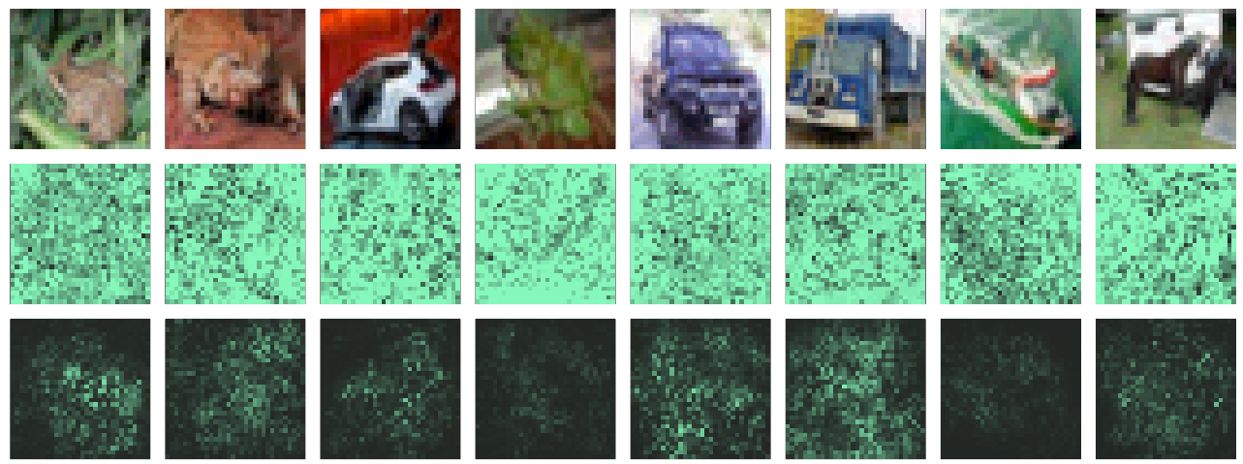
Robustness in FL (Jitter)
Advantages of Jitter
1. Higher Attack Success: Jitter boosts adversarial success rates, especially against robust models, by normalizing logits and adding noise to avoid extreme confidence levels.
2. Diverse Misclassifications: Gaussian noise in logits encourages varied misclassifications, making the attack harder to defend against.
3. Subtle Perturbations: Jitter minimizes perturbation size, making attacks less noticeable.
4. Overcomes Gradient Obfuscation: Logit scaling keeps gradients informative, avoiding common defenses like gradient obfuscation.
Disadvantages of Jitter
1. Complex and Slower: Extra steps like logit scaling and noise injection increase computational load.
2. Sensitive to Parameters: Requires careful tuning of factors like scaling and noise, impacting reliability.
3. Model Dependence: Effectiveness can vary across models, as some architectures may still resist Jitter.
4. Less Effective on Non-Gradient Defenses: Jitter struggles against non-gradient defenses, limiting its strength mainly to white-box attacks.
Alzheimer’s disease
Federated Learning
Neural Networks
Vision Transformers
Different Robustness Approaches
Our results
Robustness in FL
CE attack: second row Jitter attack: third row (less noise added)
Exploring Misclassifications of Robust Neural Networks to Enhance Adversarial Attacks
Notes:
crowds

Slide 18
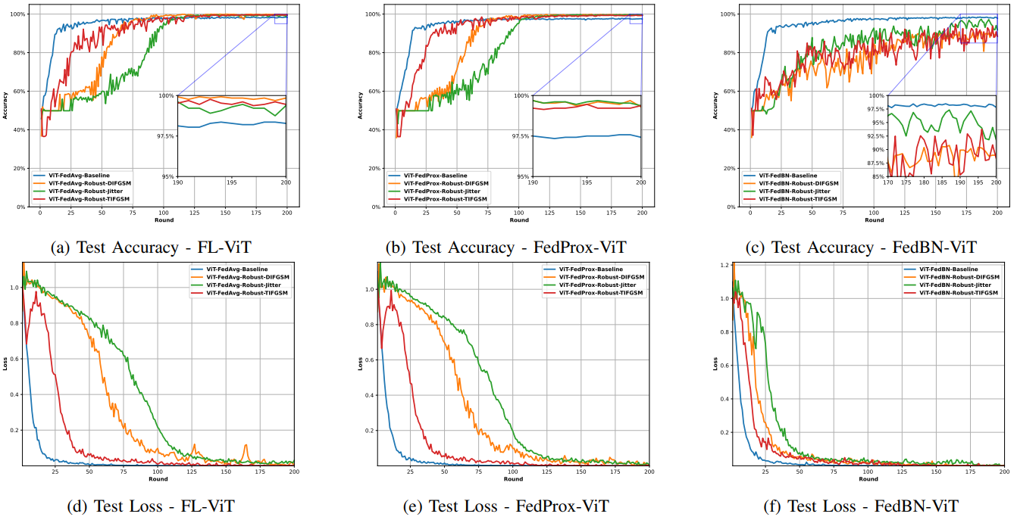
Result (Resnet18-vit)
Alzheimer’s disease
Federated Learning
Neural Networks
Vision Transformers
Different Robustness Approaches
Our results
Robustness in FL

Slide 19
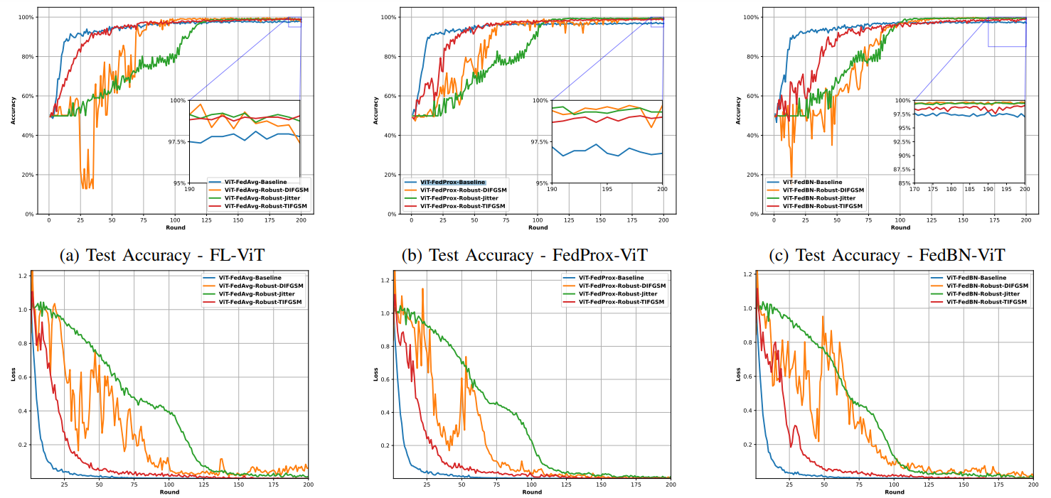
Result (densenet121-vit)
Alzheimer’s disease
Federated Learning
Neural Networks
Vision Transformers
Different Robustness Approaches
Our results
Robustness in FL

Slide 20

Result(RESNET18-vit)
Alzheimer’s disease
Federated Learning
Neural Networks
Vision Transformers
Different Robustness Approaches
Our results
Robustness in FL

Slide 21

Result(Densenet121-vit)
Alzheimer’s disease
Federated Learning
Neural Networks
Vision Transformers
Different Robustness Approaches
Our results
Robustness in FL

Slide 22
Thanks for Your Attention
22

